Slide 1
Presentation on Crop Recommendation System
By
Sagar Chaudhary(37)
Prabisha Bajracharya(26)
Rojan Chitrakar(33)

Slide 2
Table of Contents
Introduction
Objectives
Algorithm used (Random Forest Classifier)
Feasibility
System Design
Flowchart
Tools used
Dataset
Expected Outcome
References

Slide 3
Introduction
Our Crop Recommendation System is designed to assist farmers in selecting the most suitable crops based on specific environmental and soil characteristics.
Utilizes a Random Forest algorithm to analyze data such as soil pH, temperature, rainfall, and N-P-K (Nitrogen, Phosphorous and Potassium) for accurate recommendations.
Model is trained using the dataset from Kaggle.

Slide 4
Objective
To obtain a better variety of crops that can be grown over the season.
To reduce the wrong choice on a crop by application of principles of precision agriculture.
To improve crop productivity by providing predictions of high accuracy and efficiency through the machine learning algorithm.

Slide 5
Random Forest Algorithm
Random Forest is a popular machine learning algorithm that belongs to the supervised learning technique.
Step 1: Select random samples from a given data or training set.
Step 2: This algorithm will construct a decision tree for every training data.
Step 3: Voting will take place by averaging the decision tree.
Step 4: Finally, select the most voted prediction result as the final prediction result.

Slide 6
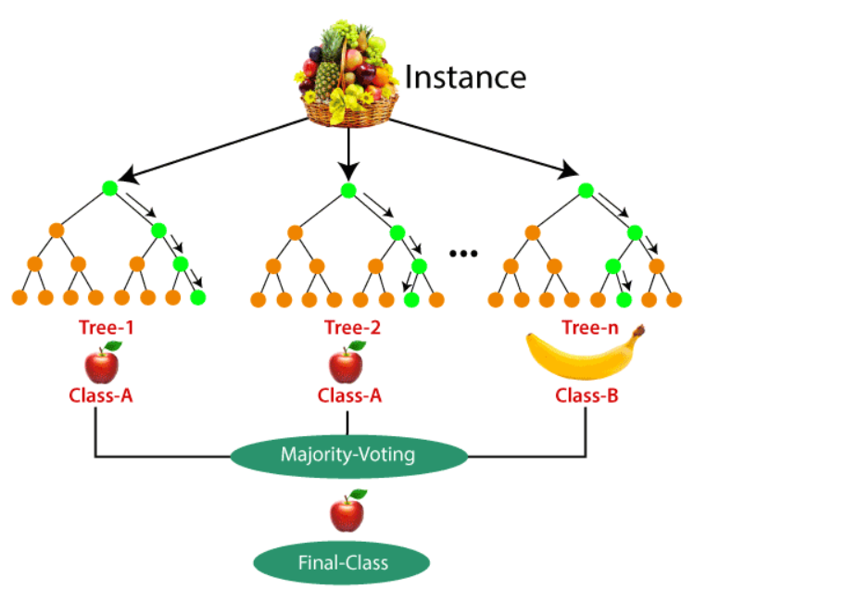
Random Forest Algorithm

Slide 7
Feasibility
It is technically feasible because A laptop with at least 8GB RAM, SSD (at least 256GB) and GPU and High Speed Internet.
It is operationally feasible because it requires only few developers.
It is economically feasible because the use of open source like python, flask.

Slide 8
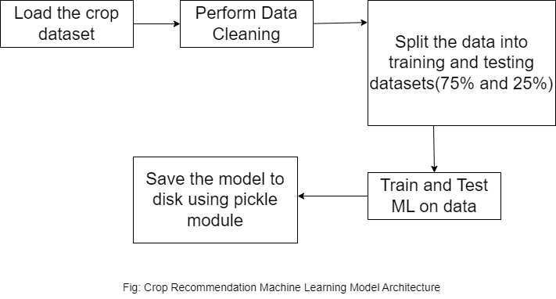
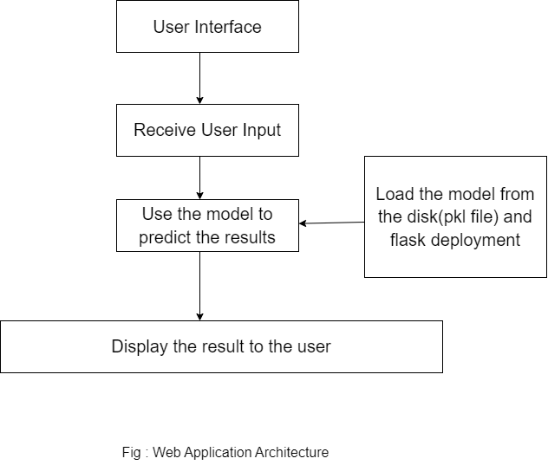
System Design
First Part Second Part

Slide 9
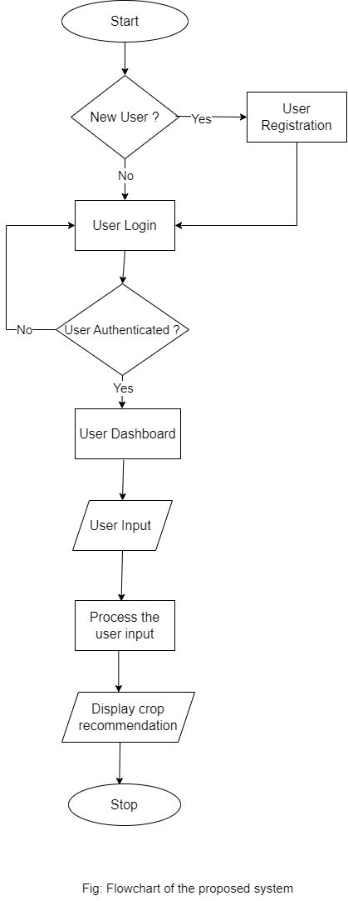
Flowchart

Slide 10

Tools used
For Front End
HTML, CSS

Slide 11

Tools used
For Back End
Python, Flask

Slide 12
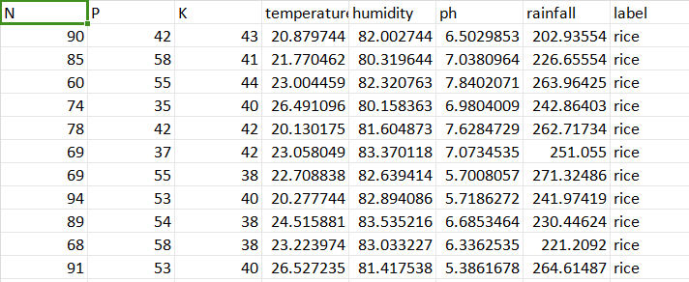

Dataset
Dataset is taken from Kaggle

Slide 13
Expected Outcome
A fully functional web app developed using html,css, python and flask.
Recommend the crop to user based on the input of the user.
Reduction in crop failure rates by considering factors such as soil type, climate.

Slide 14
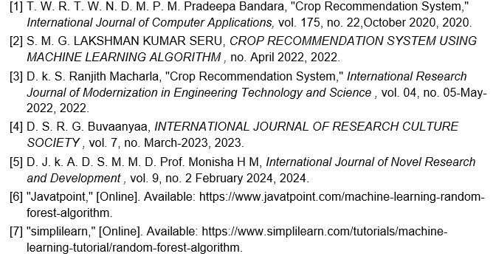
References

Slide 15


Slide 16


